Slide 2
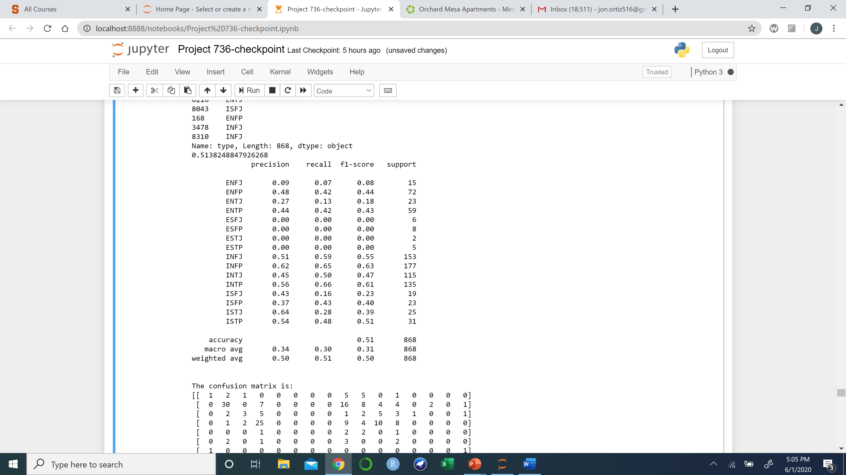
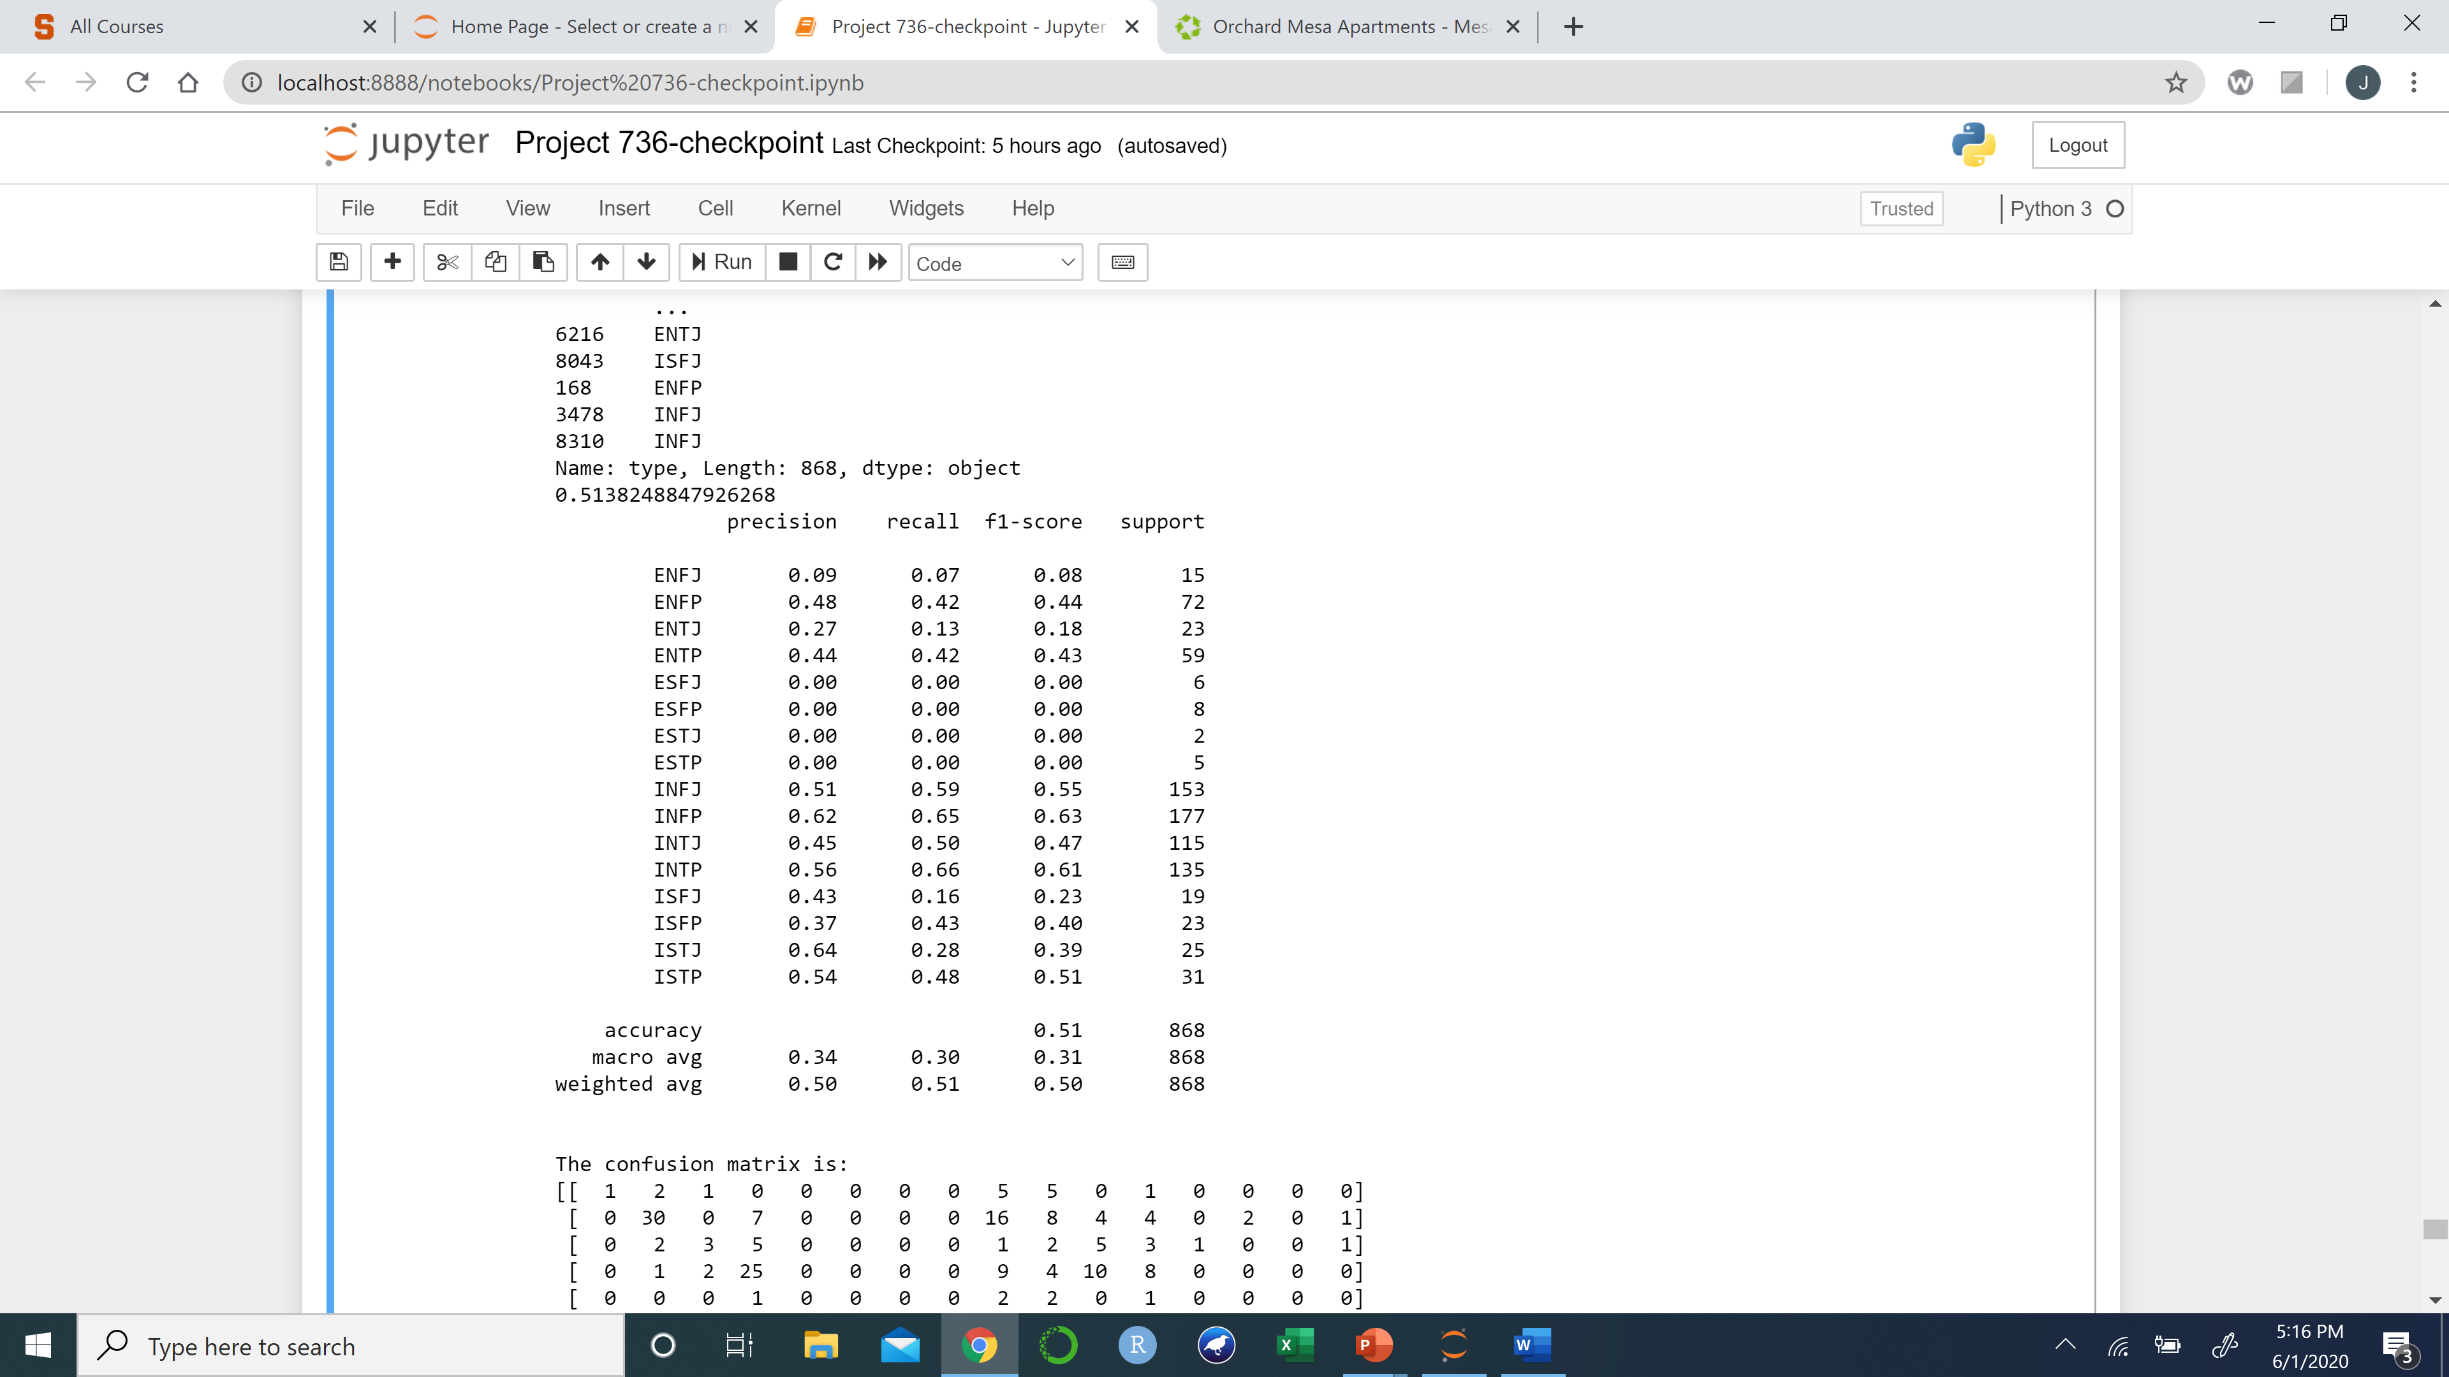
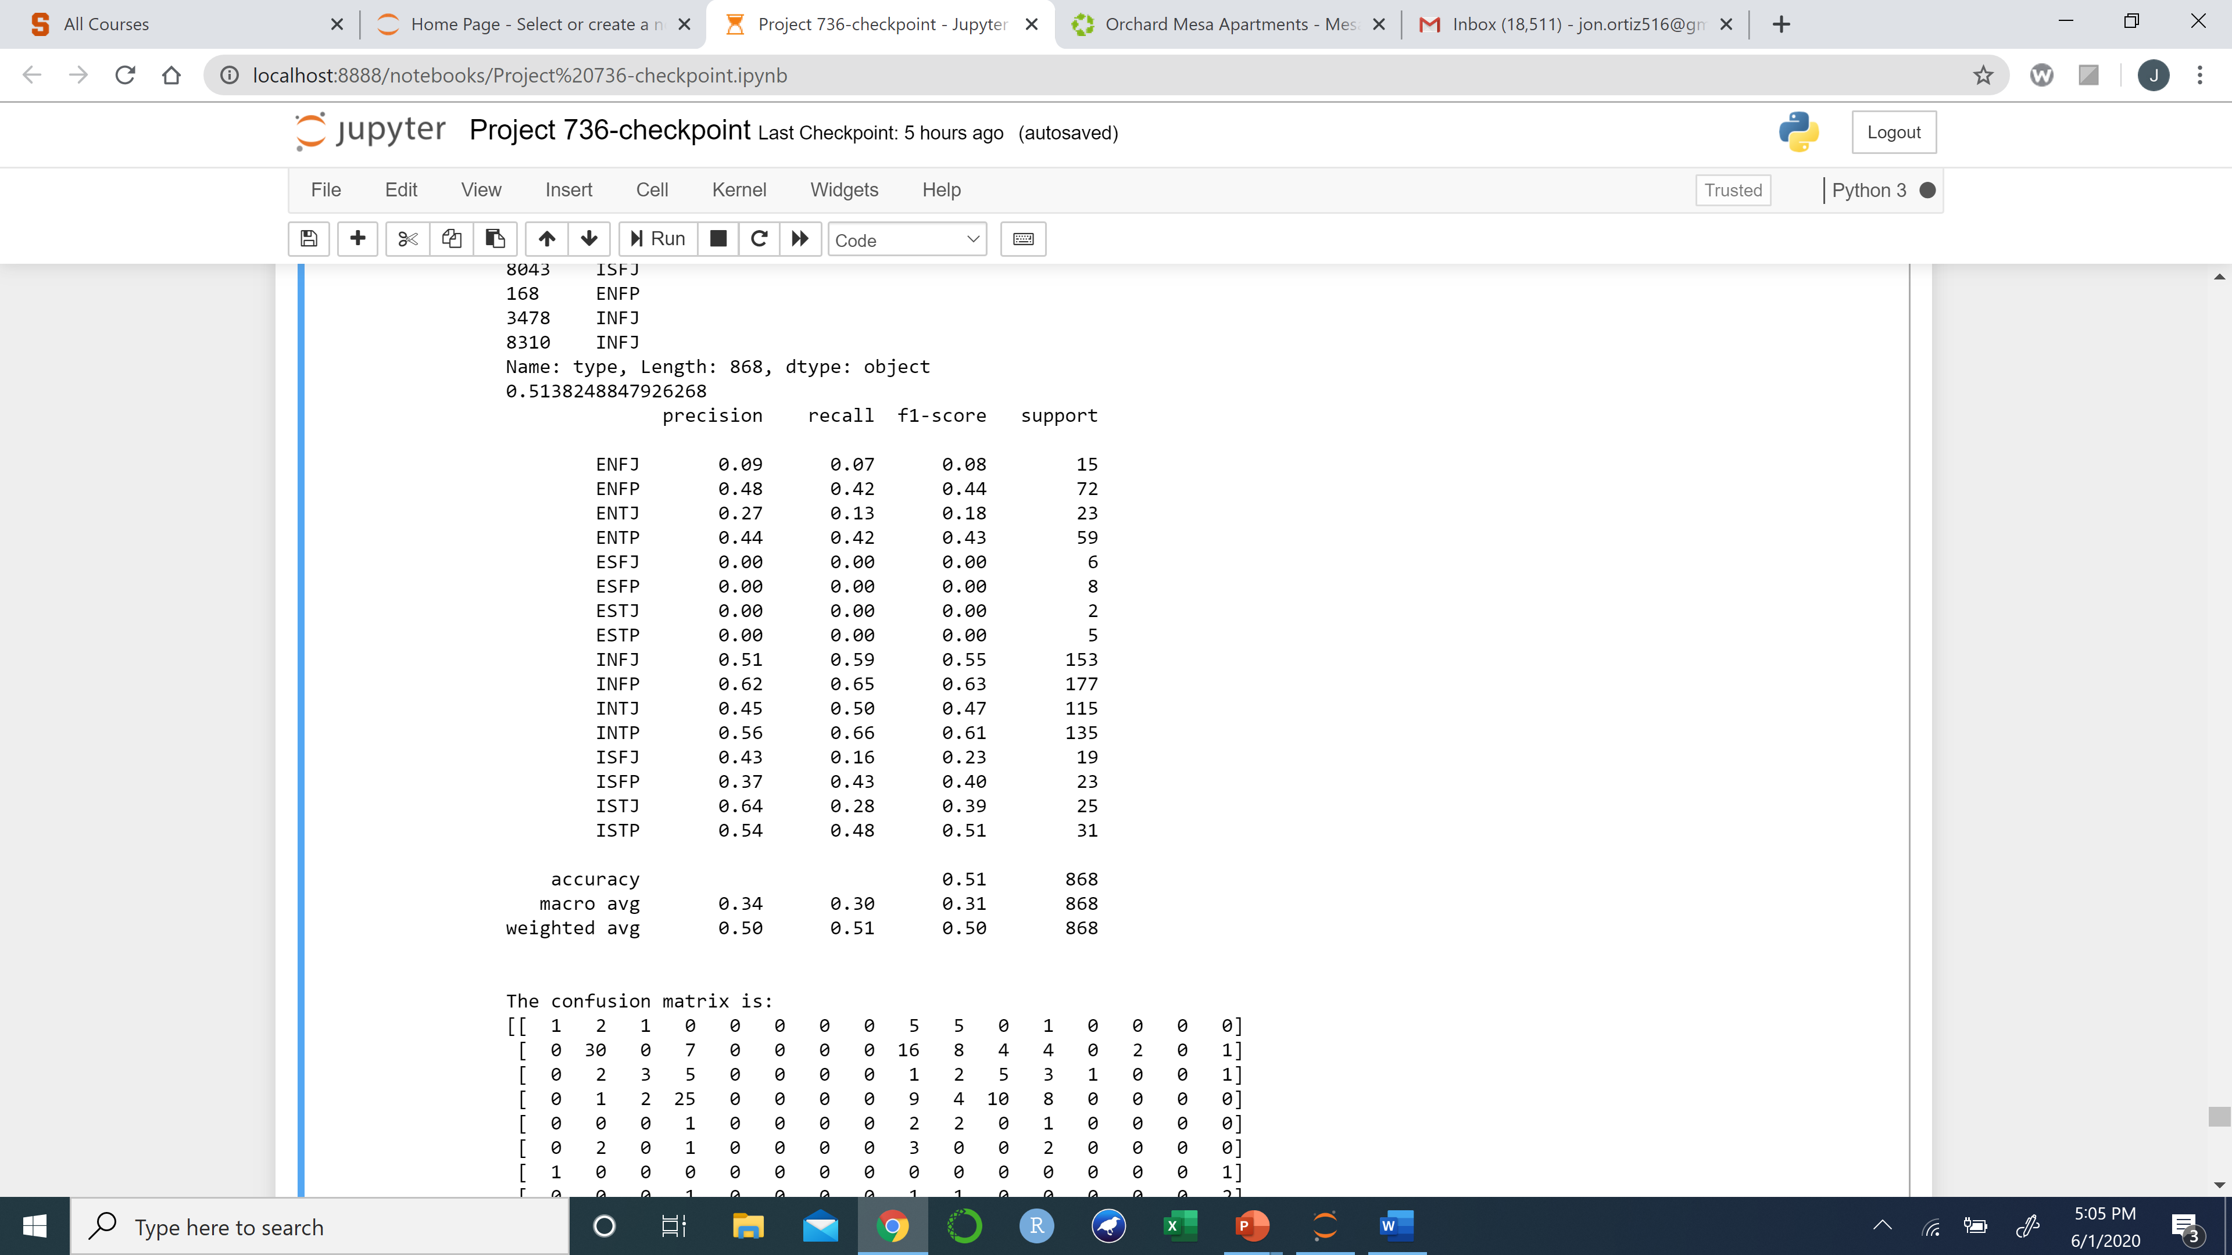
SVM’s Using Boolean Vectorizer
Linear Kernel
Polynomial Kernel
Radial Kernel

Slide 3
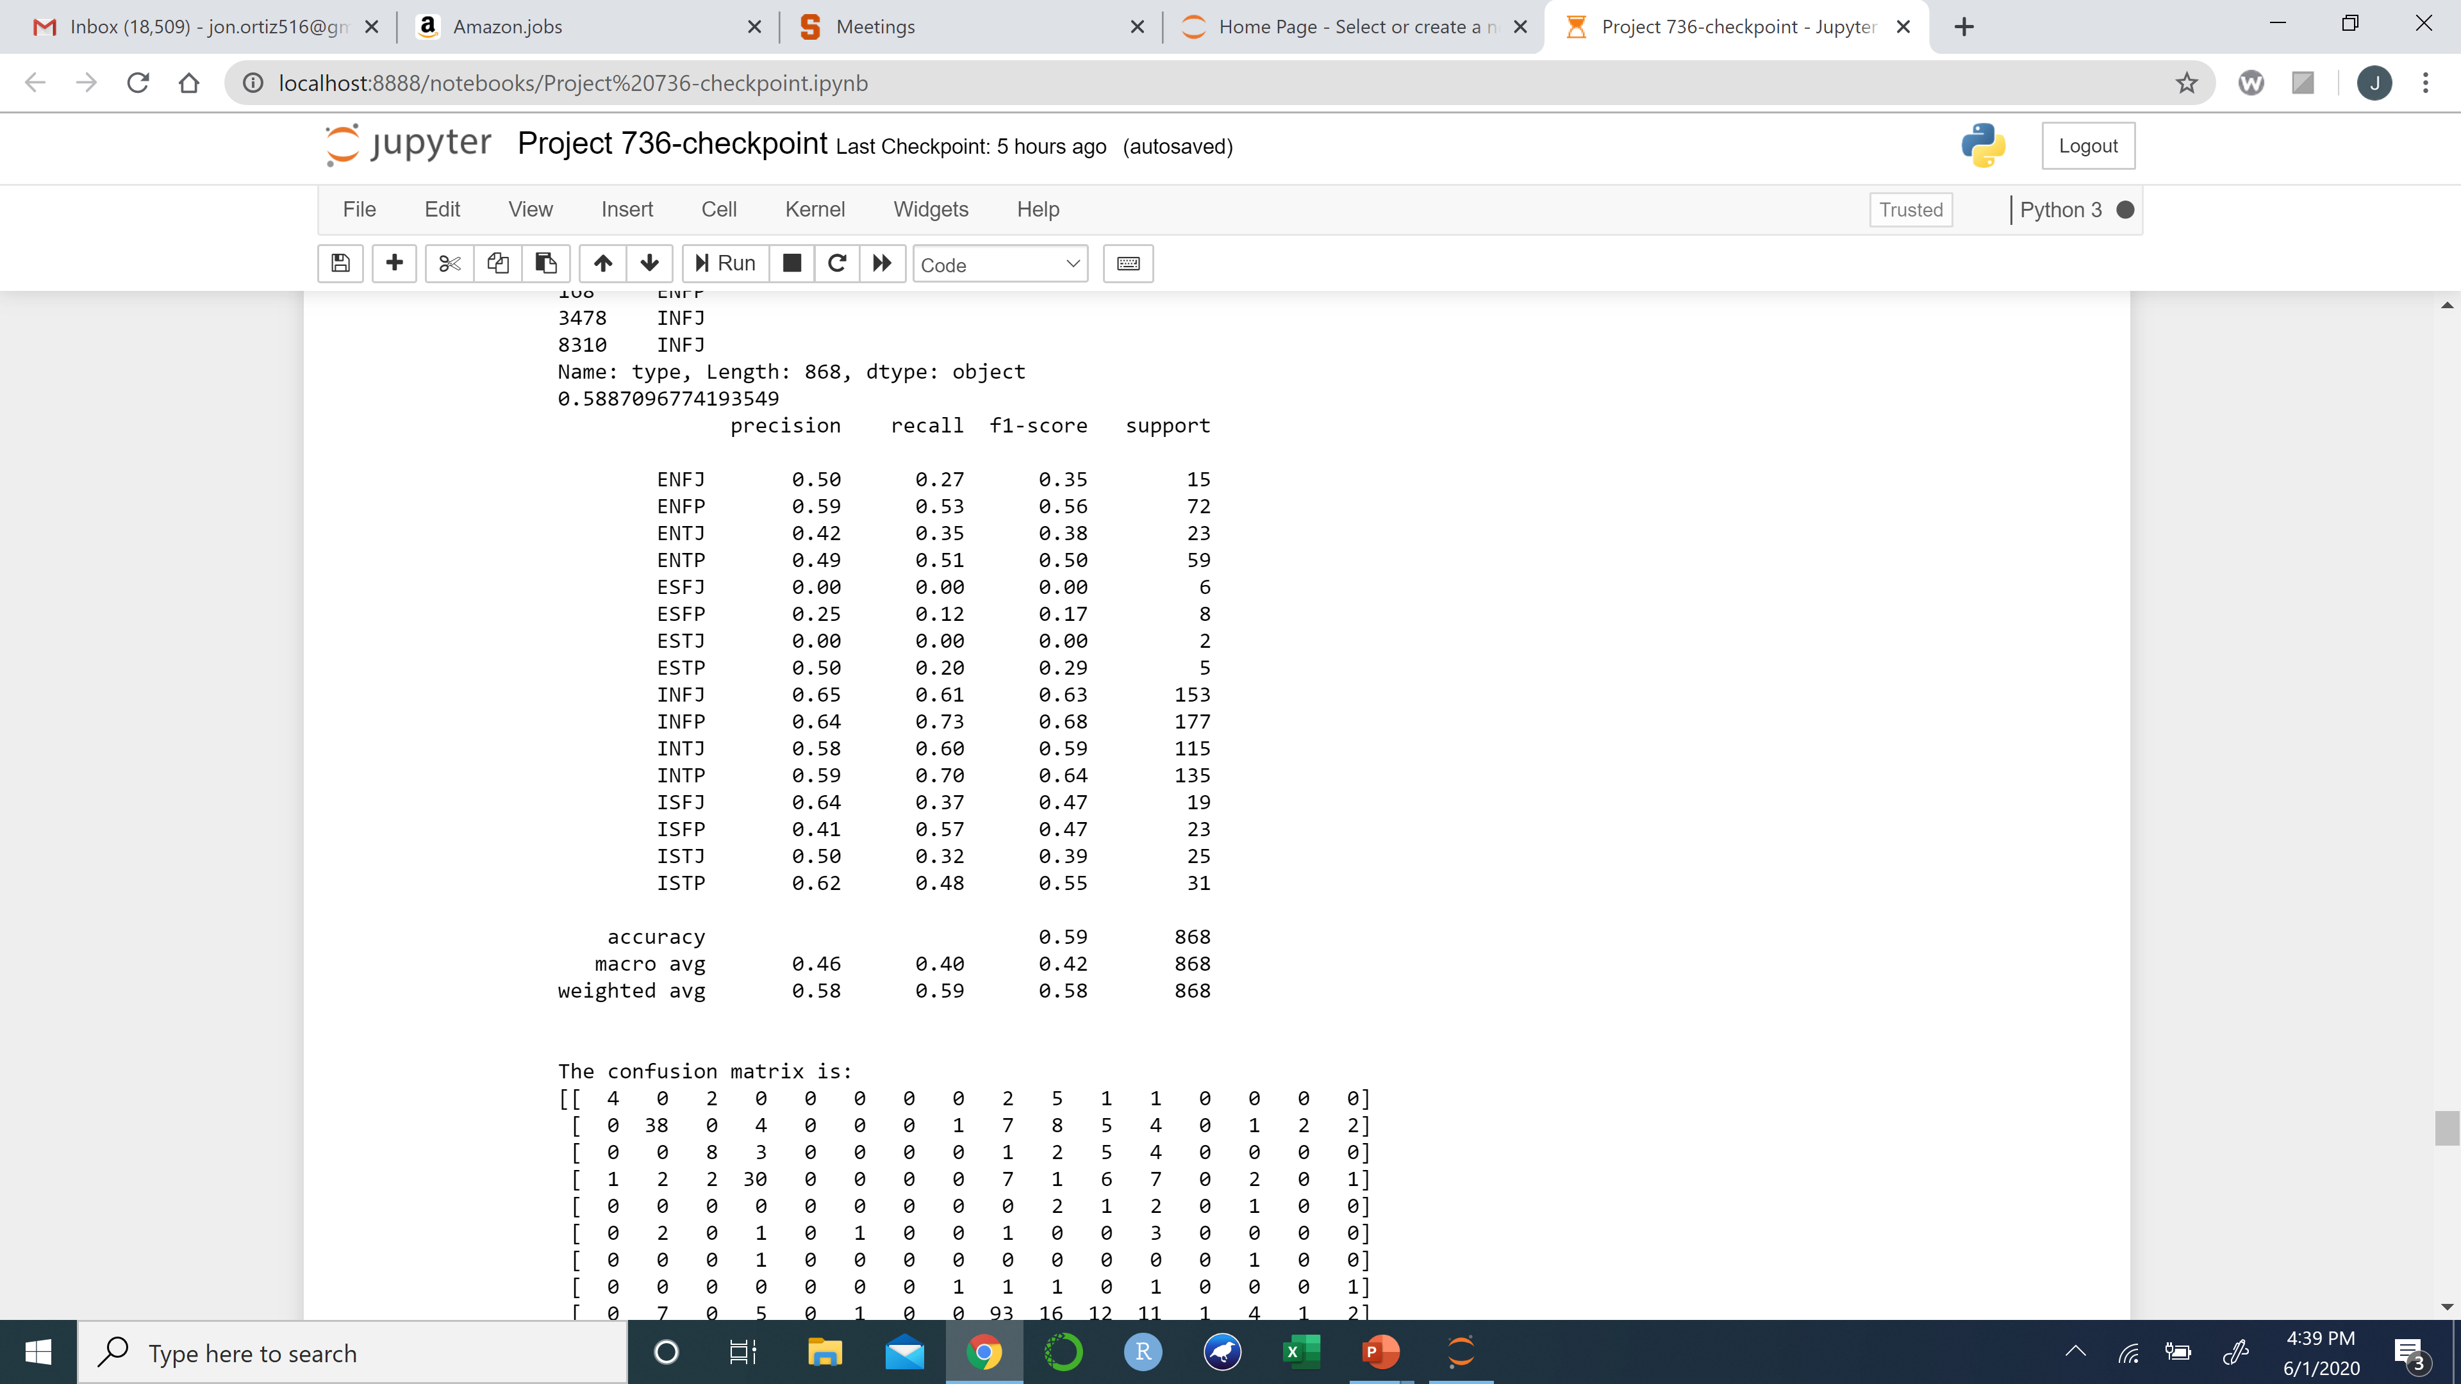
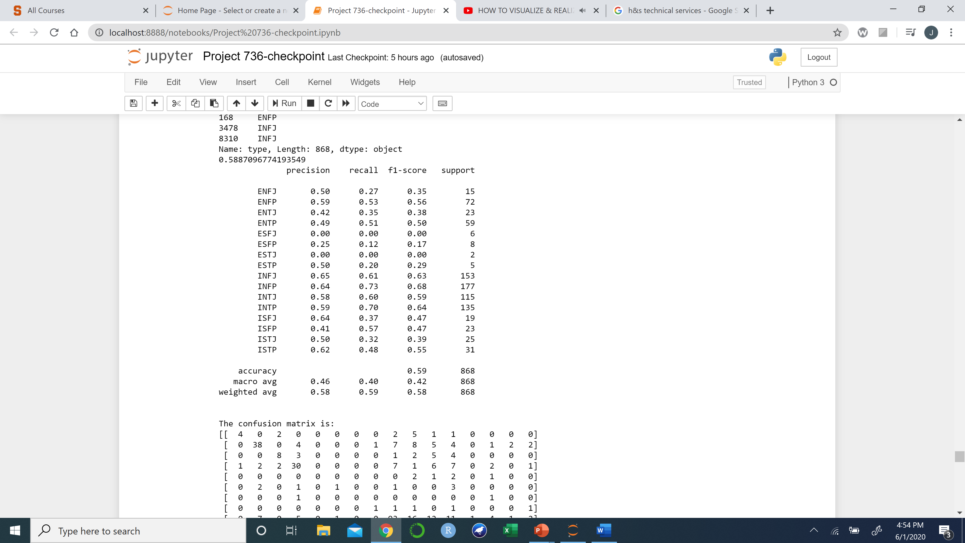

SVM’s Using Count Vectorizer
Linear Kernel
Polynomial Kernel
Radial Kernel

Slide 4
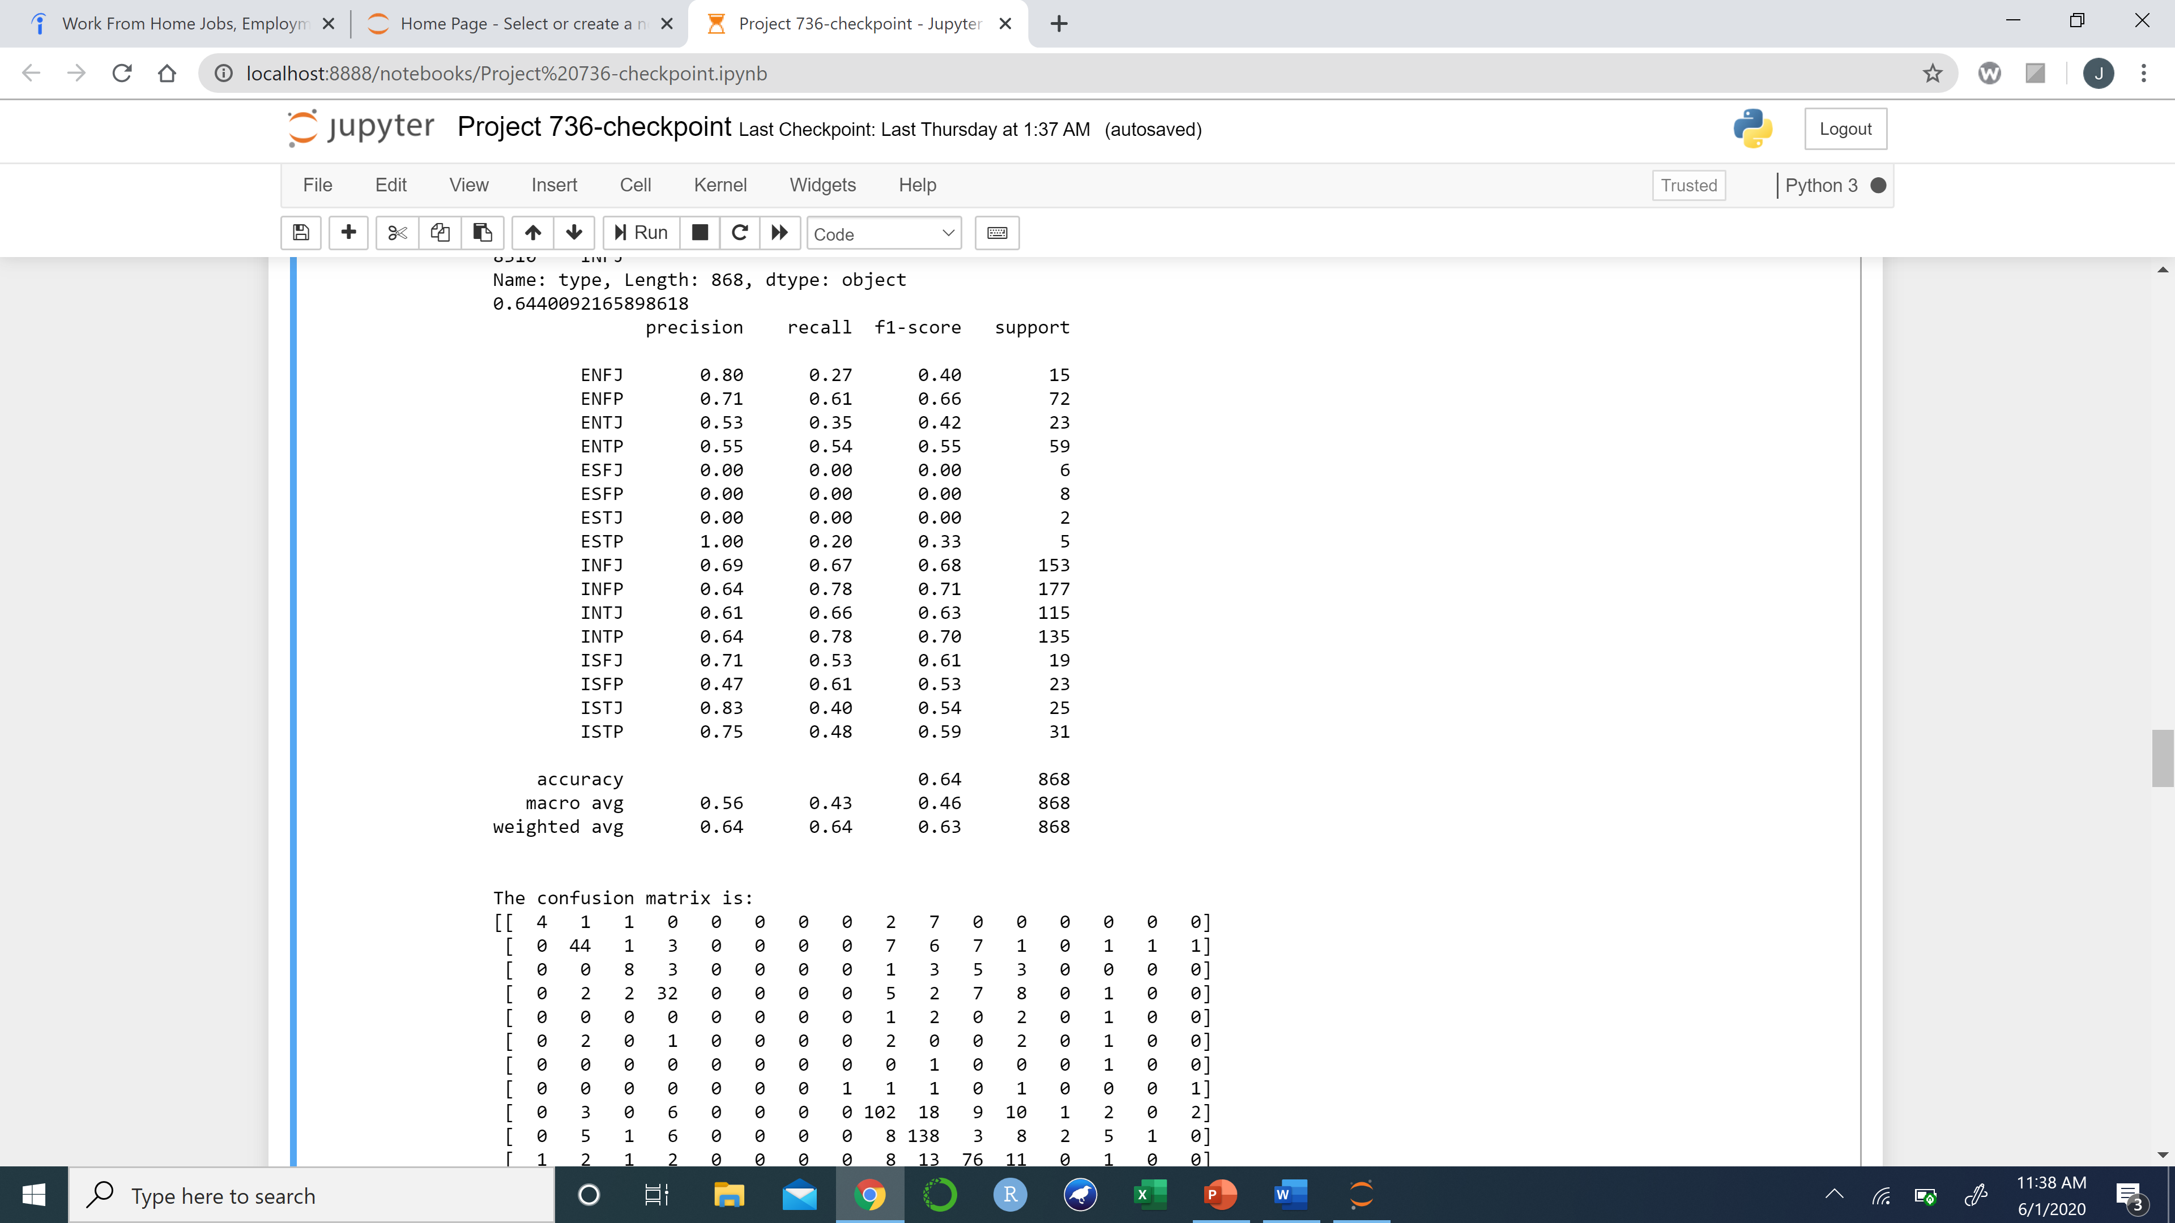
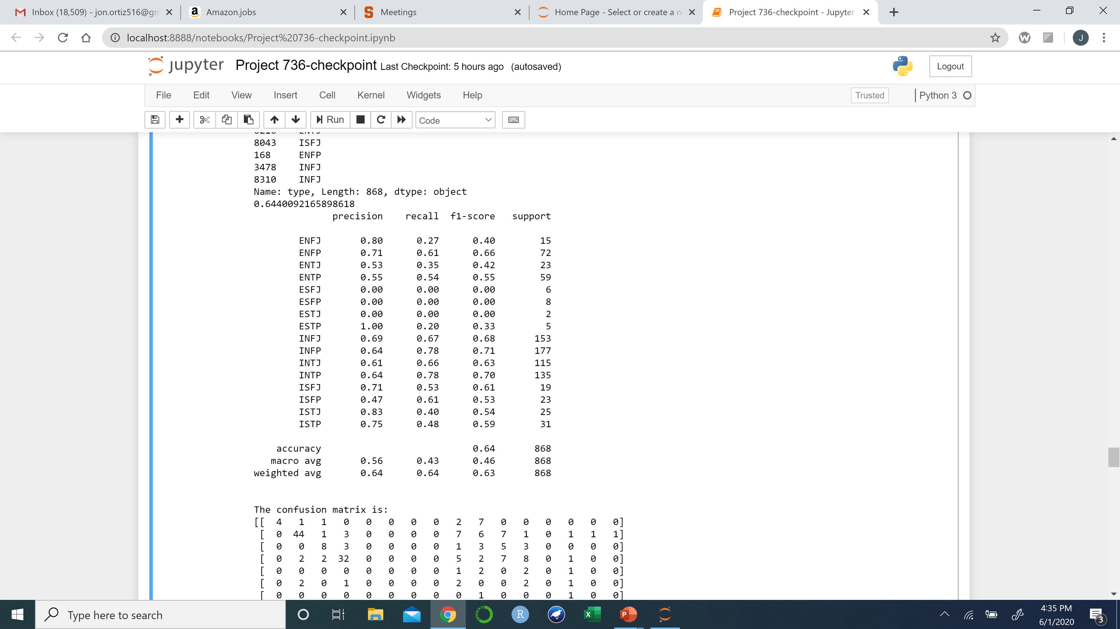

SVM’s Using TFID Vectorizer
Linear Kernel
Polynomial Kernel
Radial Kernel
The most accurate model uses the TFID vectorizer, the kernels did not make any difference with any of the other vectorizers as well as this one, they all led to the exact same result.

Slide 5

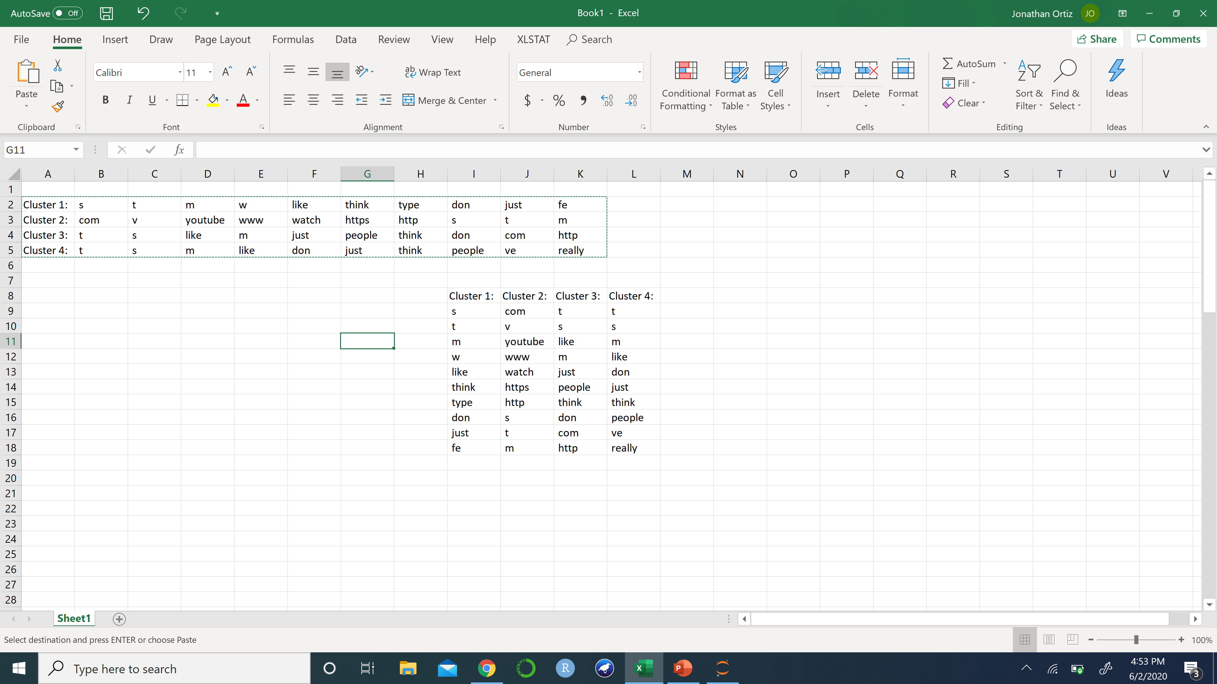
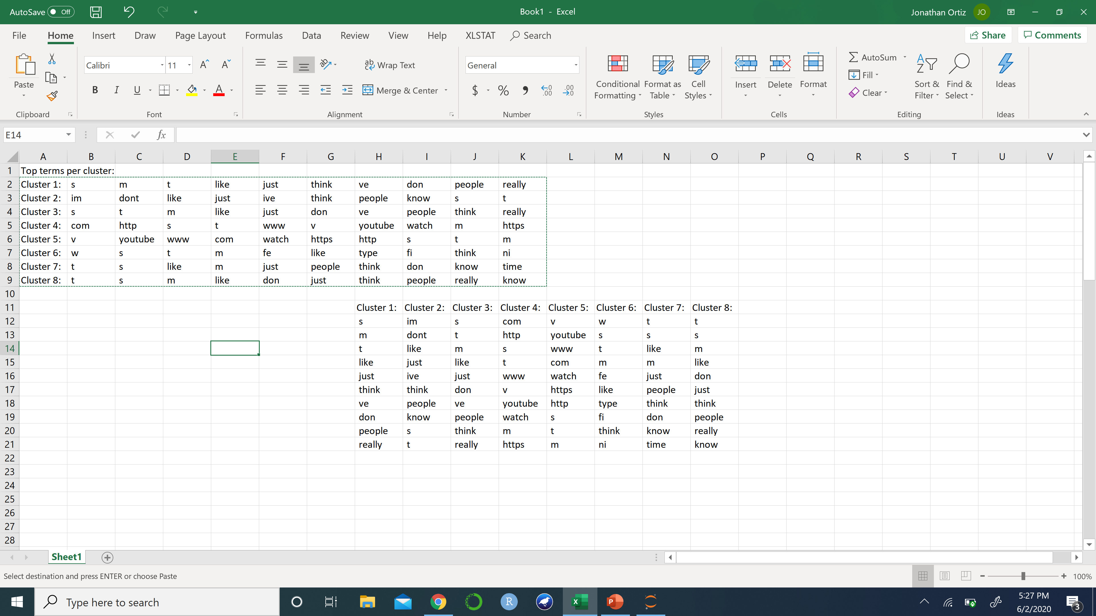
K-Means Clustering TFID Vectorizer
8 clusters
2 clusters
4 clusters
Trying multiple clusters really shows no real topics. This could be because the training data set is comments, which can all be regarding the same topics. A different data set of original posts could give us different results.

Slide 6
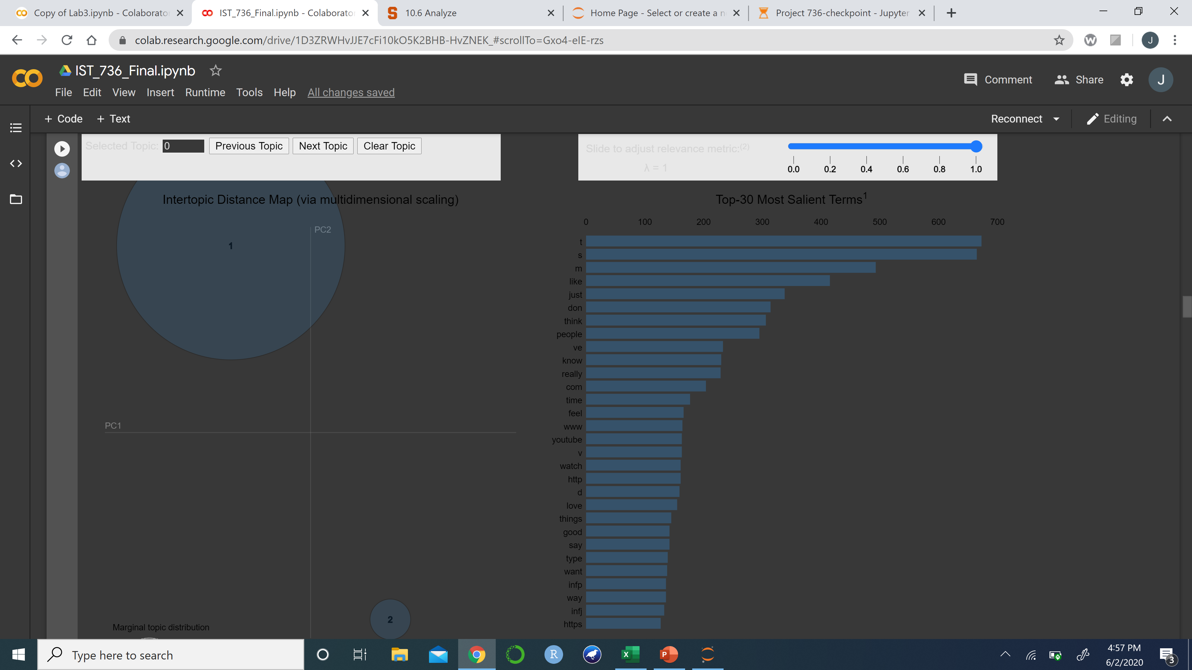
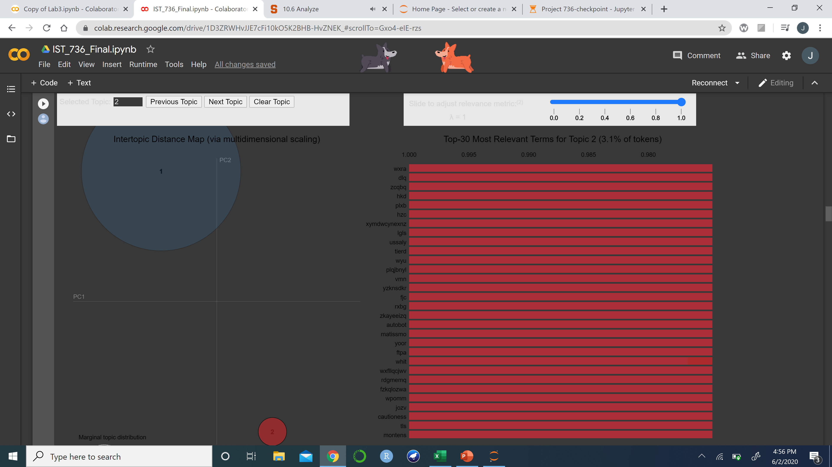
LDA Topic Model
Topic 1
Topic 2
Topic 1 seems to contain some common use English words, while topic 2 is gibberish.

